Slide 1
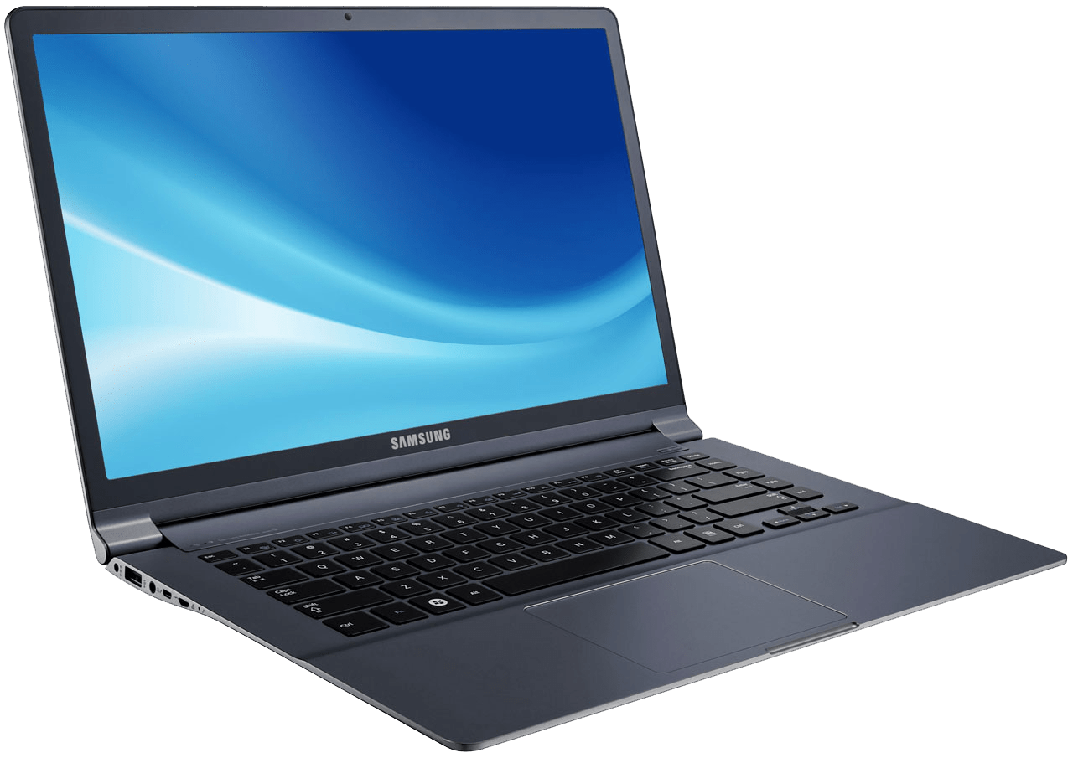
BYOD Induction
Setting students up for successful use of BYOD @ Glenmore Park High

Slide 2
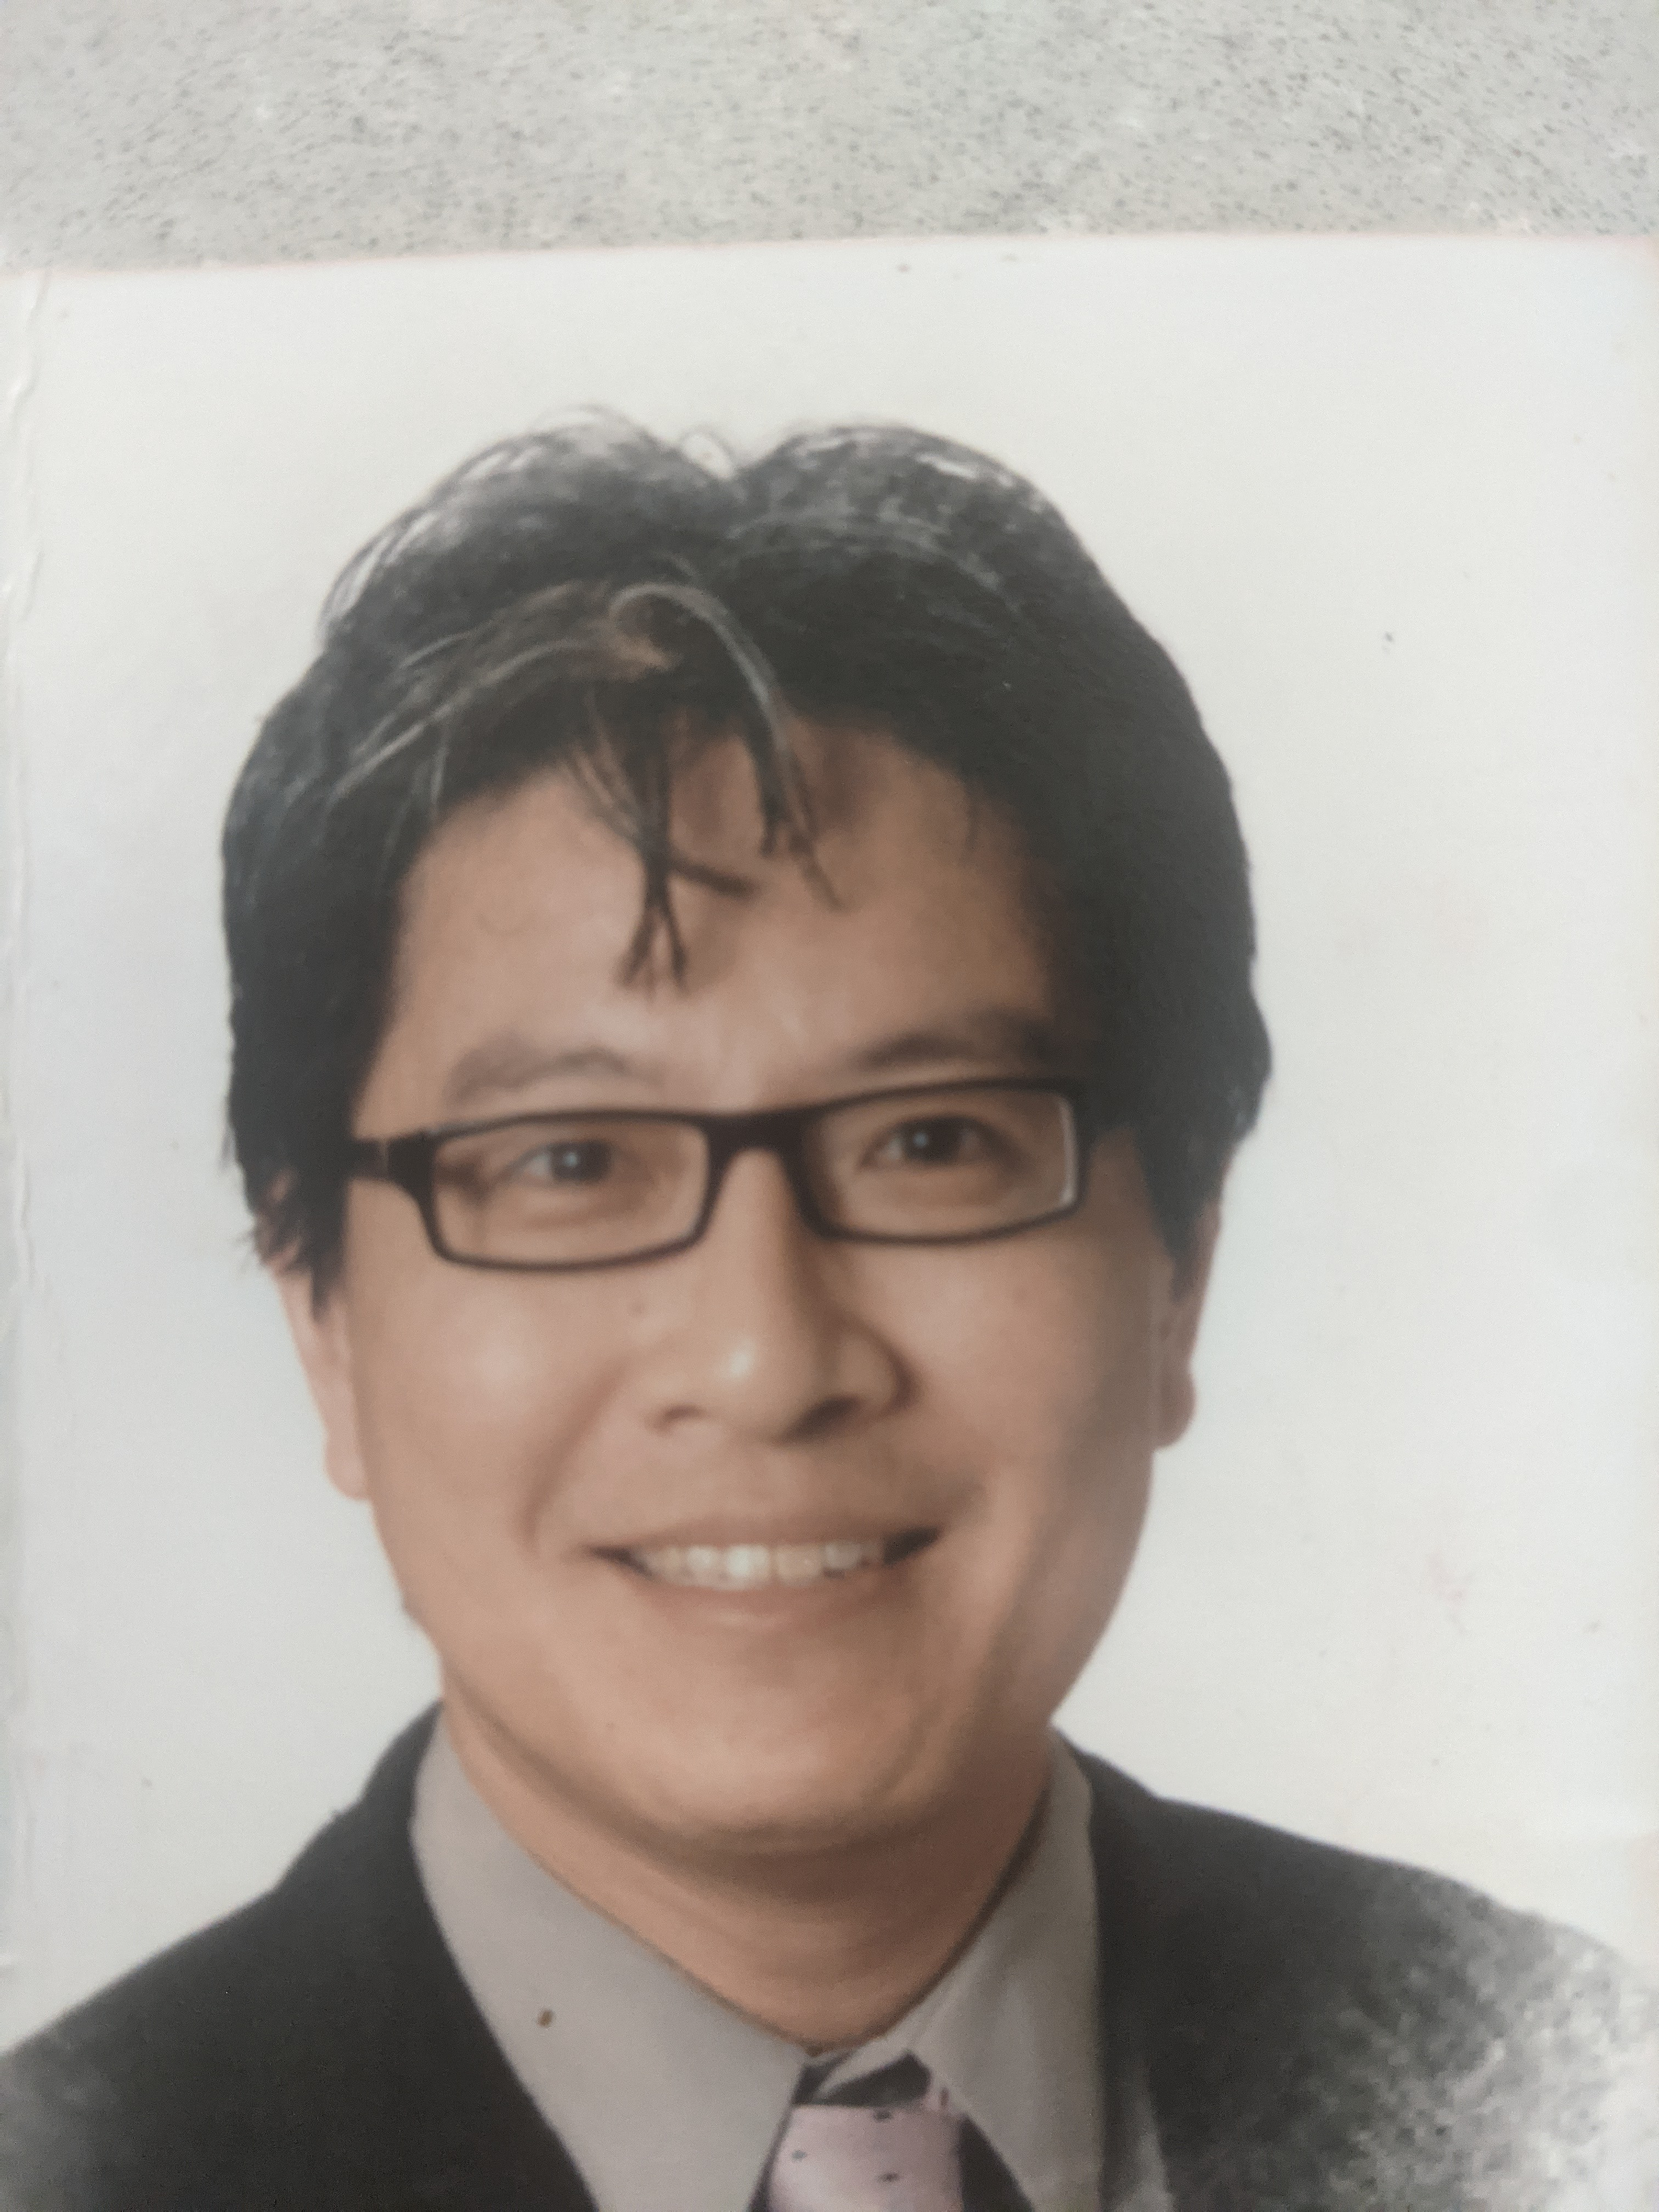
Hello!
Who: Mr Liauw
What: Computer Coordinator
Where: Library
When: Recess & Lunch
Why: Any questions relating to using your BYO device or a loan laptop from the school

Slide 3
Hello!
Who: Rhyce
What: TSO – Technical Support Officer
Where: Library
When: Anytime Mon - Wed
Why: Any questions relating to using your BYO device or a loan laptop from the school

Slide 4

Objectives
Connect to School Wifi
Connect to the Secure Edge Network
Access the Student Portal
Send an email
Join a Google Classroom - Open an assignment, complete and submit
Google Drive – Create folders for all subjects
Download Chrome

Slide 5

School Wifi

Slide 6
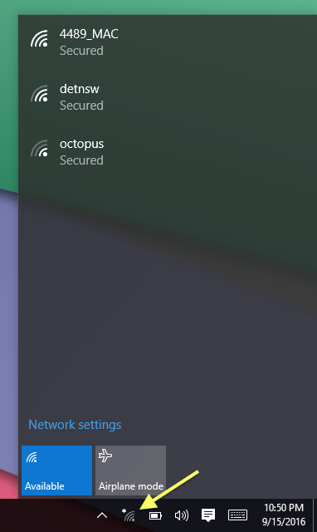
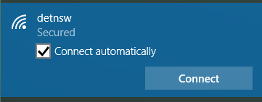
Connecting to School Wifi
Click on the Wi-Fi symbol in the bottom right corner
Click on detnsw (NOT nswdet)
Tick the connect automatically box and click connect

Slide 7
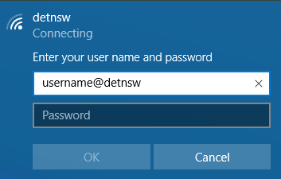
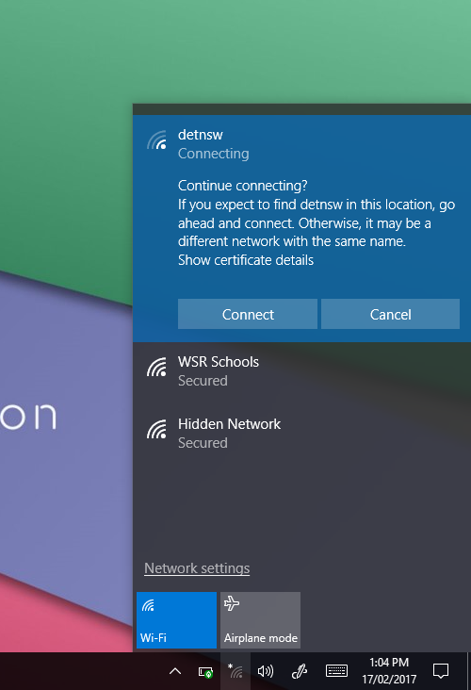
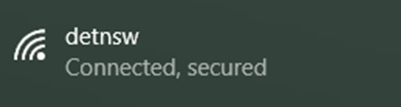
Connecting to School Wifi
4. Enter your user name and password
(if you can’t remember your username or password we can look it up and reset it for you)
User: firstname.lastname@detnsw
Password: *******
5. Click connect again.
If you have successfully connected it should say ‘Connected, secured’ under detnsw
This should happen automatically from now on

Slide 8
Secure Edge Network

Slide 9
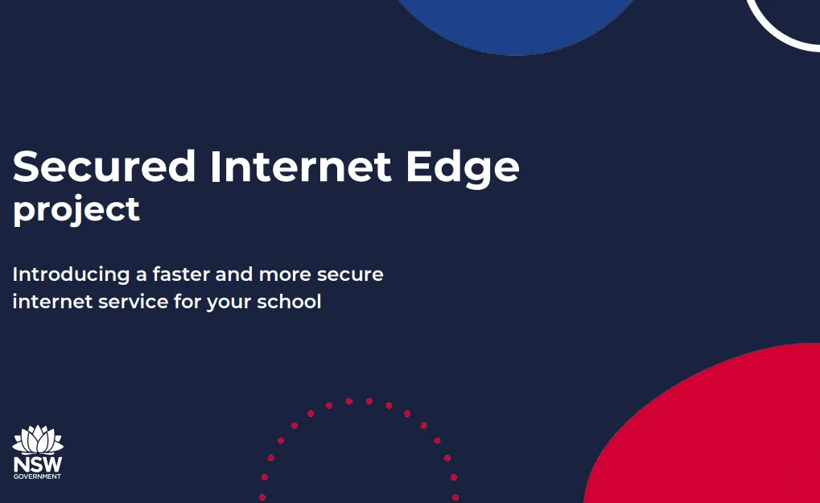
Connecting To Secure Edge Network
What is Secure Edge Network?
It is an internet service provided by the Department of Education which provides us with faster internet and protects your device from cyber threats.
What do I have to do?
Every time you open your device you must log into the Secure Edge Network

Slide 10

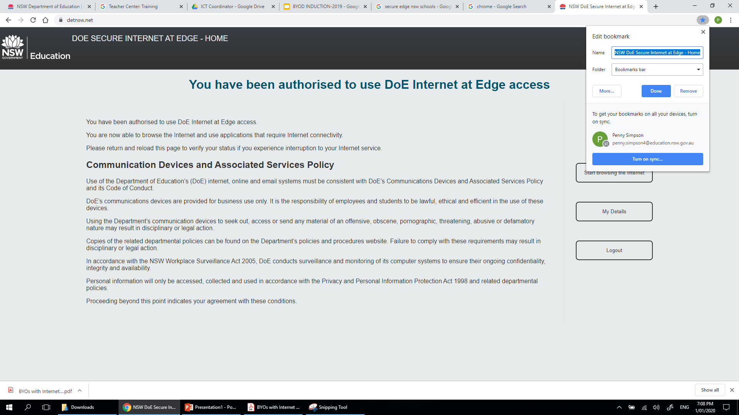
Connecting To Secure Edge Network
Open your web browser (Chrome)
Go to detnsw.net
Bookmark this page by clicking the star in the top right corner

Slide 11
Connecting To Secure Edge Network
Sign in with your school login
User: firstname.lastname@detnsw Password: *******
We can look up your username & reset your password if you have forgotten it

Slide 12
Connecting To Secure Edge Network
If your login details are correct, you will be redirected to a landing page. Then Click here to start browsing internet.
Browse the internet and use your applications as usual.
Make sure you always log out if you share your device with someone else

Slide 13
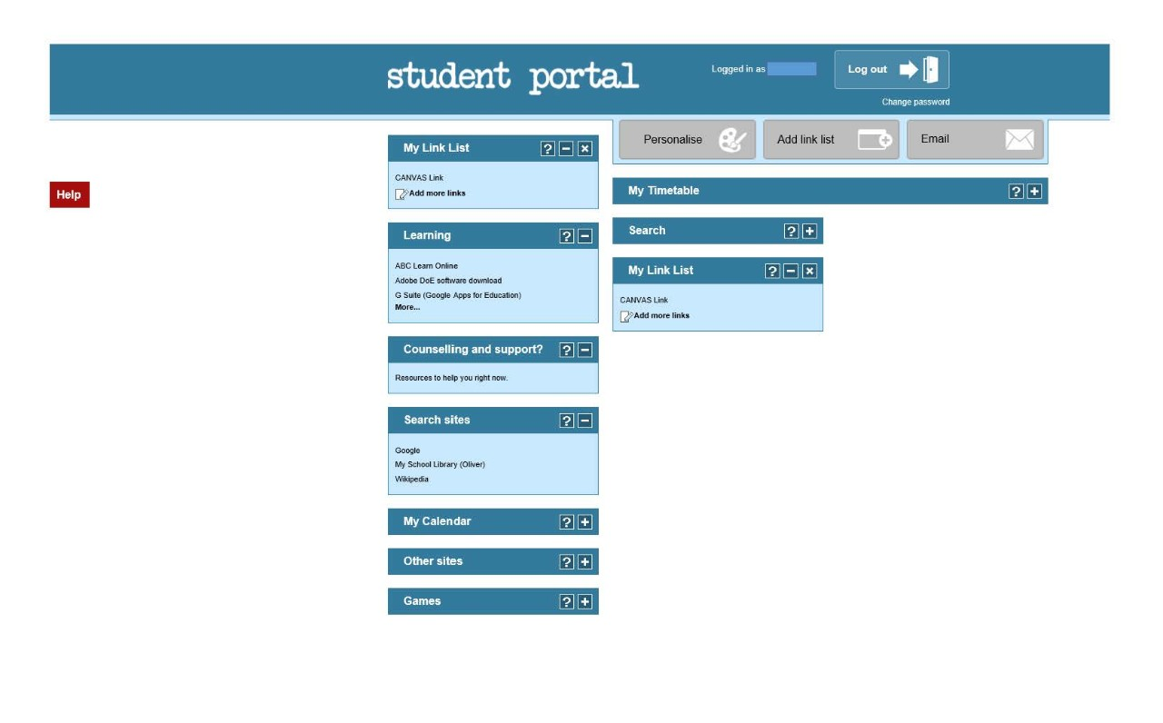
Student portal

Slide 14
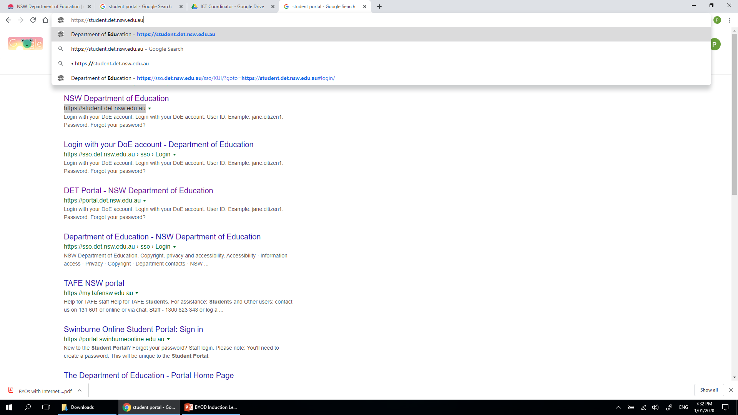

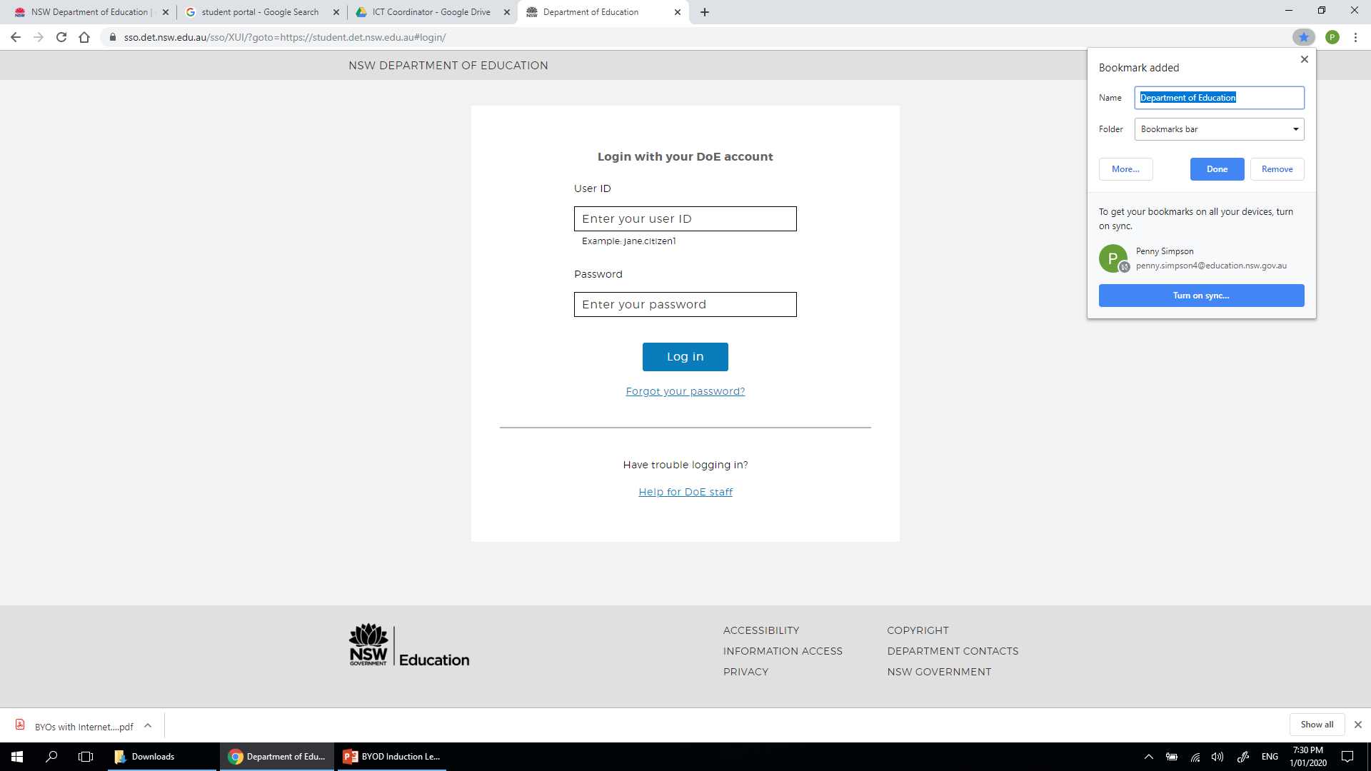
Student Portal
Go to https://student.det.nsw.edu.au
Bookmark this page by clicking the star in the top right corner

Slide 15
Student Portal
Login
User: firstname.lastname
Password: *******
This will be the same password as before
If you have a number you must ALWAYS put it at the end of your username

Slide 16
Student Portal
If your login details are correct you will be redirected to the Student Portal dashboard.

Slide 17

Student Email

Slide 18

3 minute challenge
Open your emails in your Student Portal
Send an email to the person next to you.
Your email address is
firstname.lastname@education.nsw.edu.au
3 Minute Timer
https://www.youtube.com/watch?v=UIrLyE7iz50
More help using Gmail
https://support.google.com/mail/?hl=en#topic=7065107

Slide 19
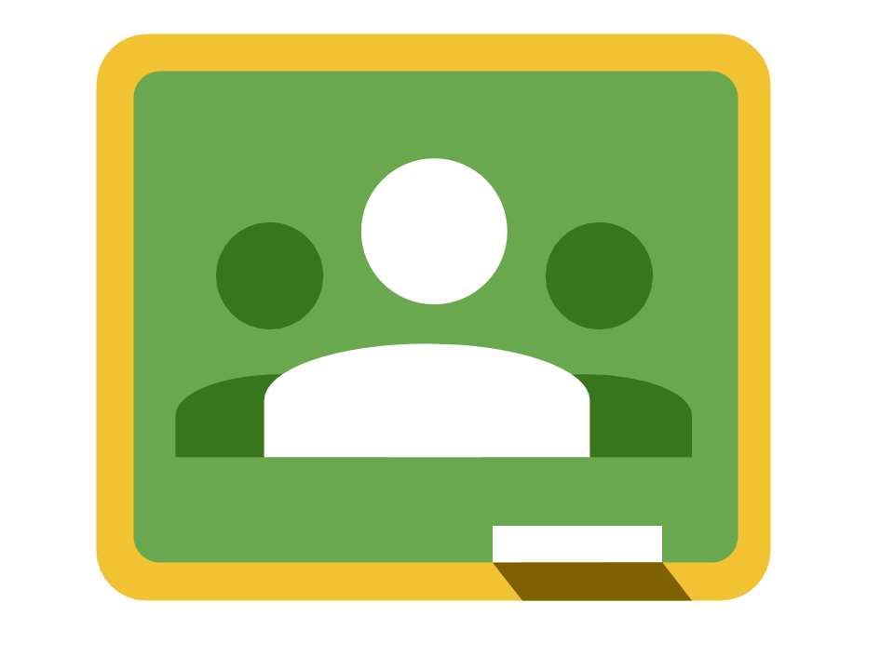
Google Classroom

Slide 20
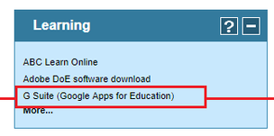
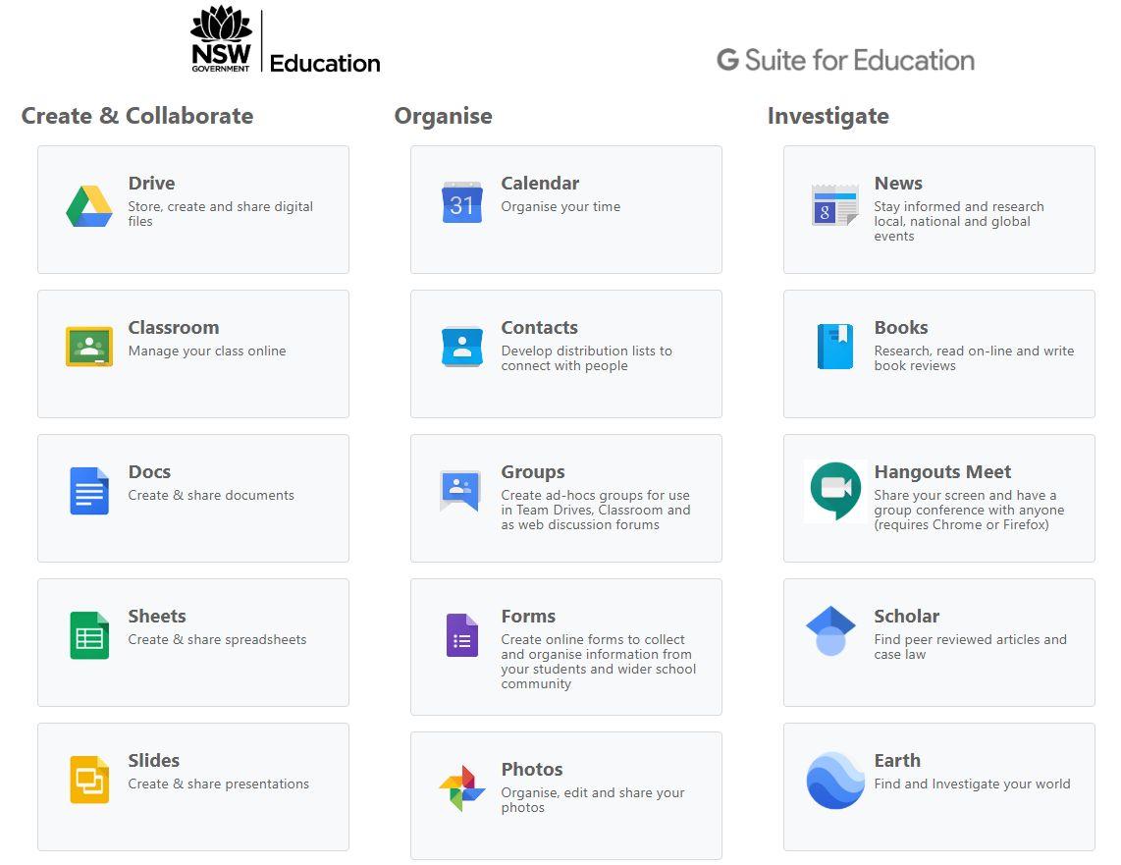
Google Classroom
Go back to the Student Portal (should be a bookmark at the top now)
Under the section that says ‘Learning’ click on G Suite
Click on Google Classroom

Slide 21
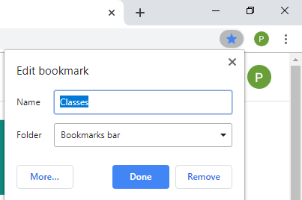
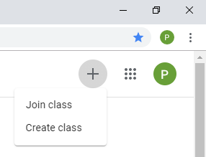

Google Classroom
Bookmark Google Classroom
Join a Google Classroom by clicking on the + in the top right and selecting ‘Join Class’
Enter the code

Slide 22
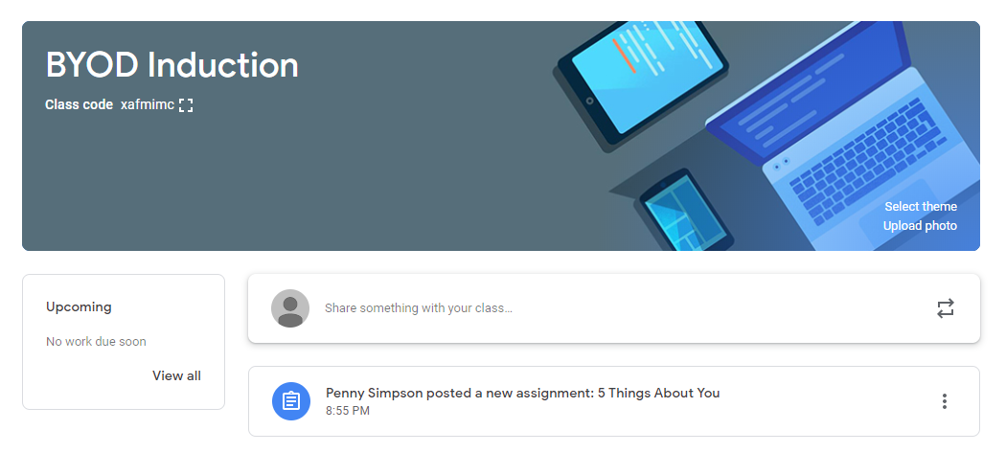

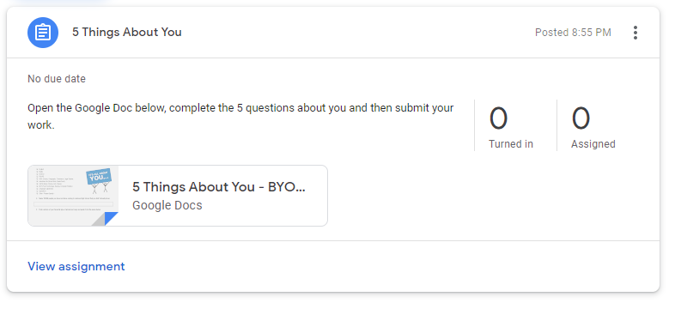
Google Classroom
Open the lesson called ‘5 Things About You’
Open the Google Doc attached to the Lesson
Complete the 5 questions
Submit your work by clicking the ‘submit’ button in the top right corner
More help using Google Classroom
https://support.google.com/edu/classroom#topic=6020277

Slide 23

Google Drive

Slide 24

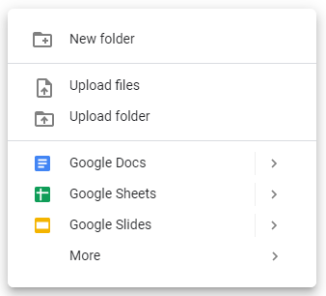

Google Drive
Go to Student Portal
Go to G Suite
Open Google Drive (bookmark this too)
Create a New folder for every subject on your timetable (right click)
Save all you work on Google drive so you can access it from anywhere, anytime on any device.
More help using Google Drive
https://support.google.com/drive/?hl=en#topic=14940

Slide 25

Chrome

Slide 26

Use Chrome as a default browser
Chrome is the most suitable internet browser for students to use at school, particularly as we use many Google applications such as Google Classroom, Drive, Docs, Sheets, Forms etc.
To download Chrome go to https://www.google.com/chrome/

Slide 27
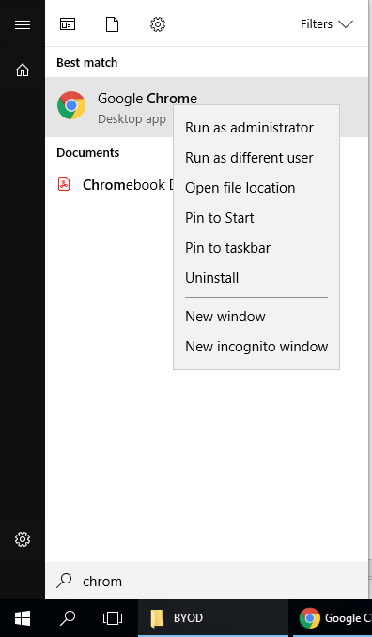
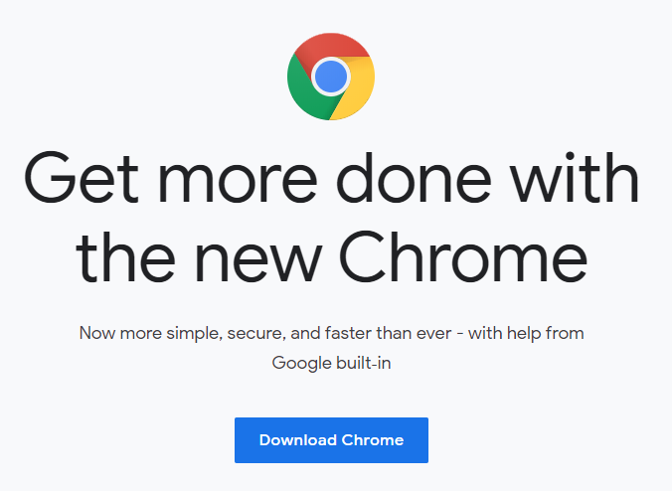
Download Google Chrome
Check to see if your laptop has Chrome – if it does skip to step 4.
If you don’t have Chrome go to: https://www.google.com/chrome/
Click download Chrome (may take 2 – 5 mins)
Find Chrome in your windows
Right click and pin to task bar
Now Chrome will be easy to open whenever you need it!

